Slide 1
STIX™ COA Extension
USING OPENC2 for automated response
Feb 25 2016

Slide 2
Agenda
Discuss design strategies for the OpenC2 Structured action – 10 min
Gather feedback on straw man (XML schema) – 15 min
Start work on JSON schema – 30 min
Next steps and wrap up – 5 min

Slide 3
OpenC2

Slide 4
OpenC2 ACTIONS
Effects-based Courses of Action
Response Actions
Alert
Contain/Impede
Investigate
Correct/Restore
Terminate
Redirect
Interact
Configure
Perform Operation
Event/Notification
Permissions/ Access Controls
Process Controls
Data Management
Allow
Deny
Start/Stop
Pause/Resume
Restart
Set/Remove
Update
Query
Report
Locate
Move
Modify
Notifications
Acknowledge
Status
Notify
Effects-based Courses of Action that can be achieved through any number of response actions
Effects-based Courses of Action as higher level “response actions”

Slide 5
OpenC2 ACTION SYNTAX
<ACTION> ([TARGET, specifiers], [ACTOR, specifiers], [modifiers])
verb object subject
ACTION gathers and conveys information, controls devices and processes
TARGET is the object of the ACTION
e.g., device, person, process, network, data
ACTOR is performing the ACTION
specifiers identify individual ACTOR or group of ACTORs
accommodates hierarchies, inheritance, lists
modifiers provide additional contextual information
e.g., time, frequency, degree/extent, priority, location

Slide 6
OpenC2 Draft

Slide 7
STIX COA

Slide 8
STIX Course of Action - Standalone
Block traffic to a particular IP address

Slide 9
STIX Course of Action – Embedded

Slide 10
COA vocabulary

Slide 11
STIX Extension options

Slide 12


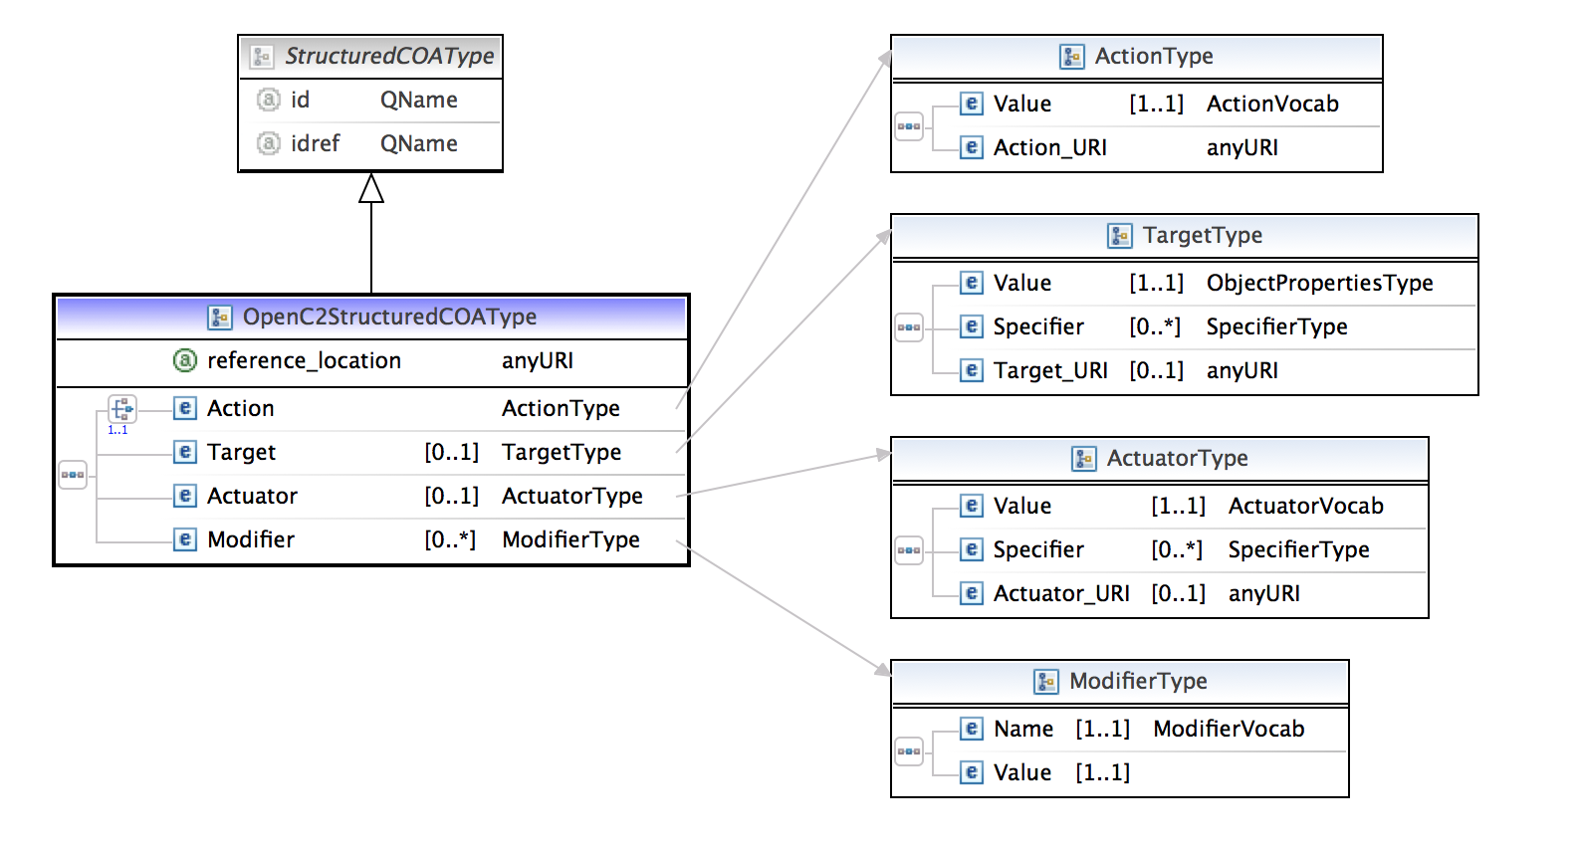
Option 1
Extend StructuredCOAType to define all the fields of the OpenC2 action construct - action, target, target-specifier, actuator, actuator-specifier and modifier

Slide 13
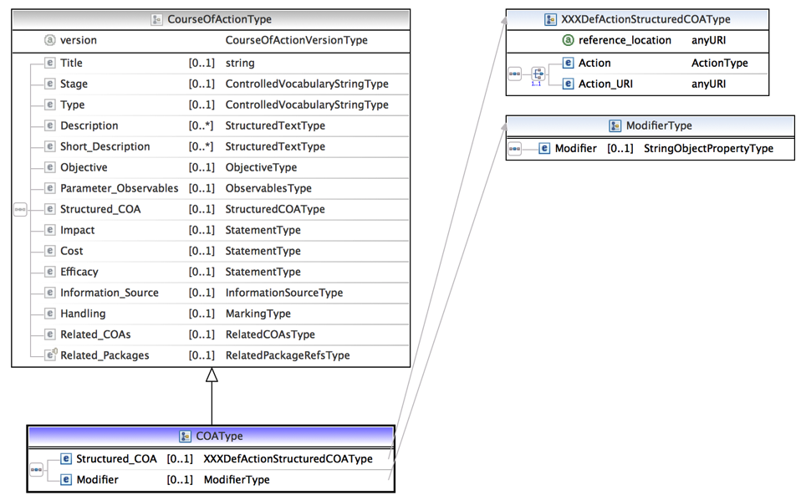
Option 2
Extend CourseOfActionType to define modifier and structured action.
Target -> Parameter_Observables
Actuator -> Information_Source
Extend StructuredCOAType to define action

Slide 14
Data Model

Slide 15
JSON

Slide 16
XML

